Slide 1
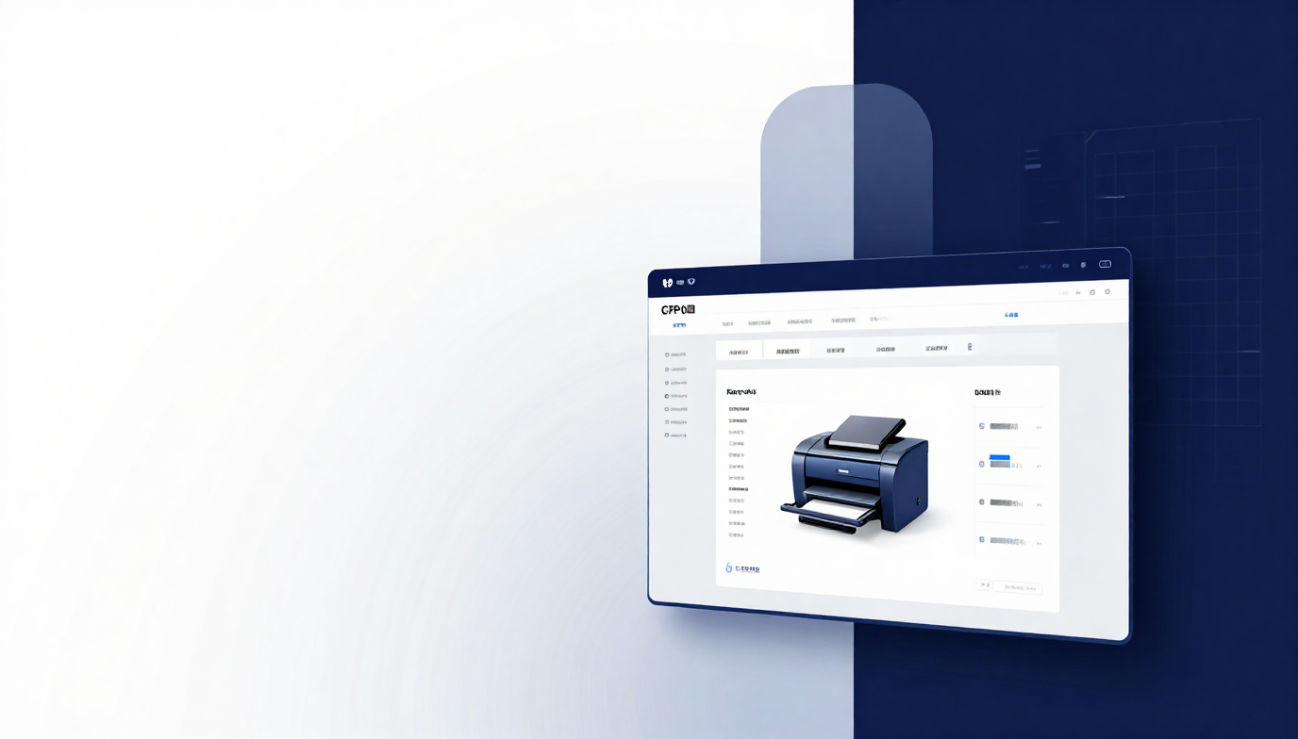

Alamia Print ERP
Faculty of Computer Science & Engineering
Alamia Print ERP System

Slide 2

02
Home
About
Product
01
Business Problems
02
Proposed Solution
Manual inventory errors · Complex material tracking · Inefficient production planning · High paper waste · No centralized data control
Centralized ERP integrating all functions · Automated order & inventory management · Layout optimization algorithm · Role-based authentication

Slide 3
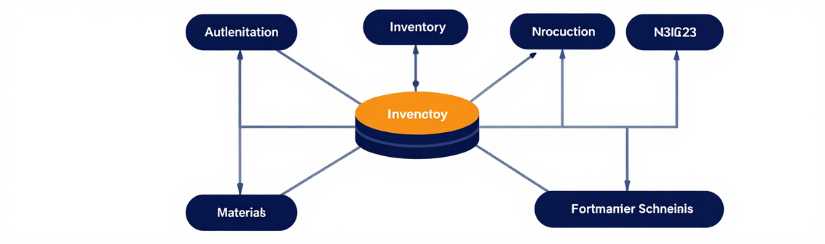
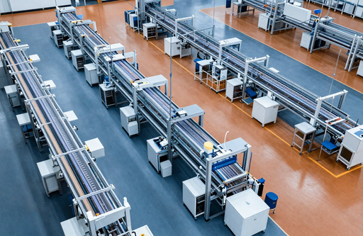
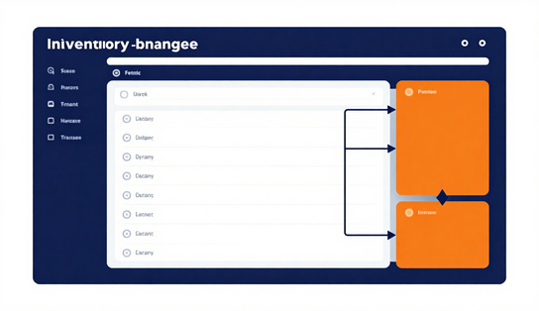
03
Home
About
Product
Authentication & Users
Materials Management
Production Orders
Role-based access control and user management
Paper, Ink, and Chemical inventory tracking
End-to-end order lifecycle and status management
System Modules Overview
All modules connect through a centralized data layer. Companies, Products, and Materials feed into Production Orders. Business Logic handles optimization and calculations. Inventory adjusts automatically on order execution, ensuring accurate stock control across the entire workflow.

Slide 4
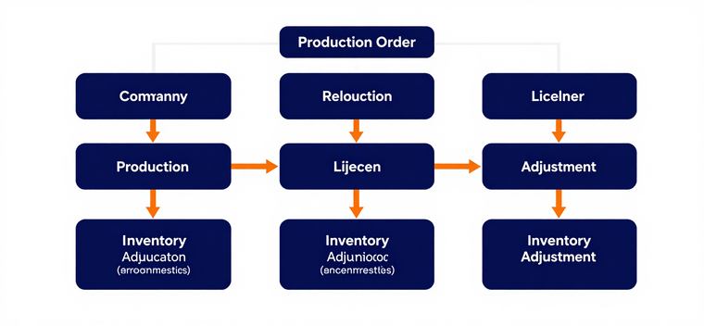
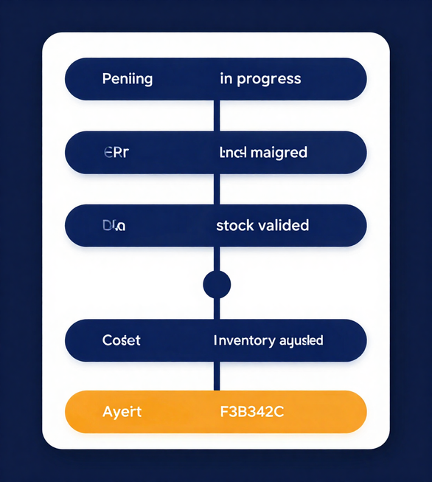
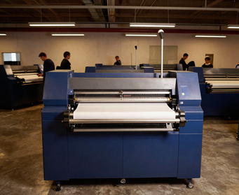
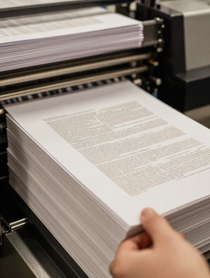
04
Home
About
Product
Production Order
Workflow
Company → Product → Quantity → Select Paper → Select Inks & Chemicals → Optimization & Calculations → Stock Validation → Production Order → Production Status → Inventory Adjustment
Key Data: Company, Product, Quantity, Paper, Ink(s), Chemical(s), Required Sheets, Status & Description.

Slide 5


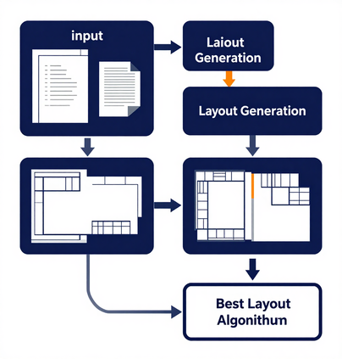


05
Home
About
Product
Paper Layout Optimization
01
02
Algorithm Overview
Evaluates 700+ layout combinations to find the optimal arrangement of product pieces on paper sheets, minimizing scrap and waste.
Optimization Output
Selects best layout maximizing pieces per sheet, then calculates exact number of sheets required for the production order.

Slide 6
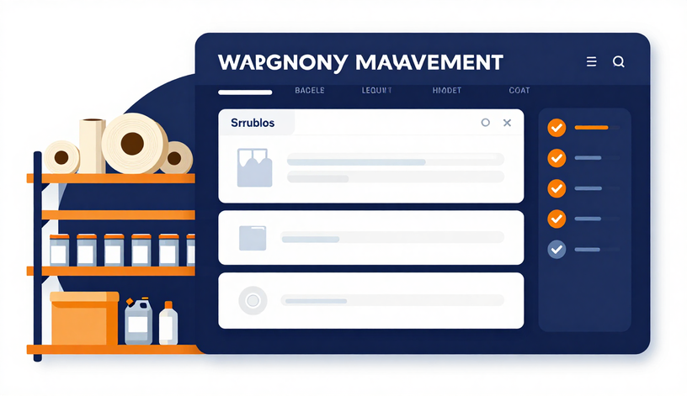
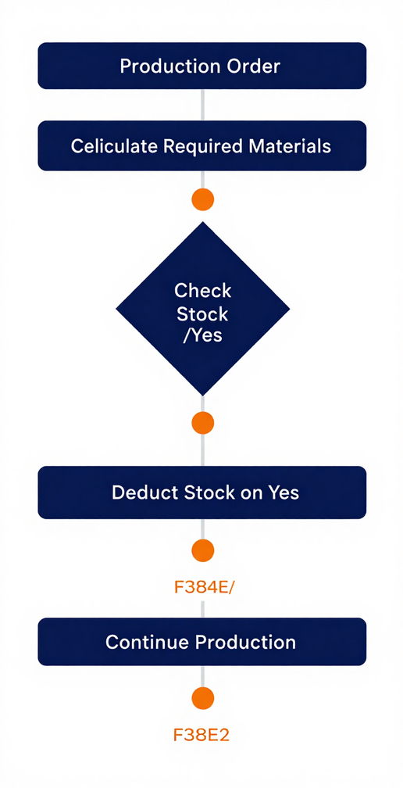



06
Home
About
Product
Stock Validation
Prevents negative inventory on production start
Auto Deduction
Materials deducted automatically when order begins
Inventory & Stock Management
Materials Tracked
Paper, Ink, and Chemicals monitored in real time

Slide 7
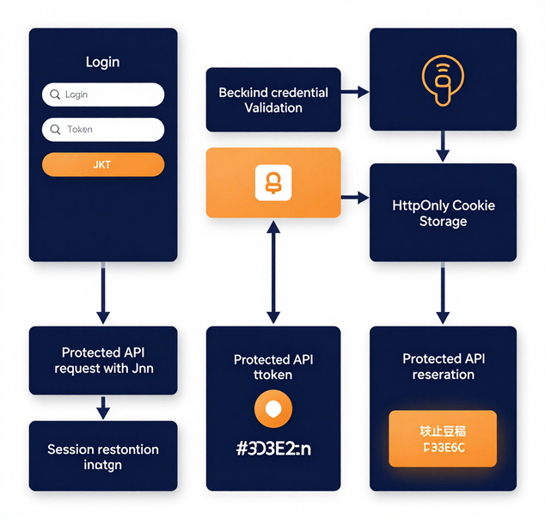
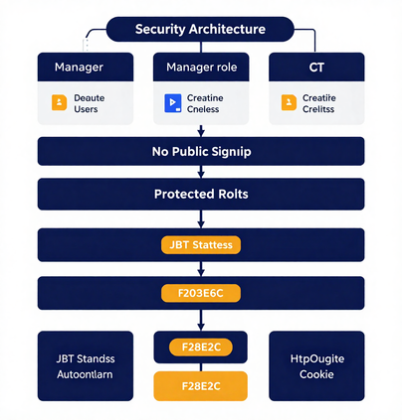


09
Home
About
Product
Authentication & Security
01
02
Authentication Flow
Login → JWT generated → HttpOnly cookie → Protected API requests → Session restore via /auth/me → Logout.
Security Design
Stateless JWT for scalability. HttpOnly cookie prevents XSS attacks. Role-based access control enforced.

Slide 8
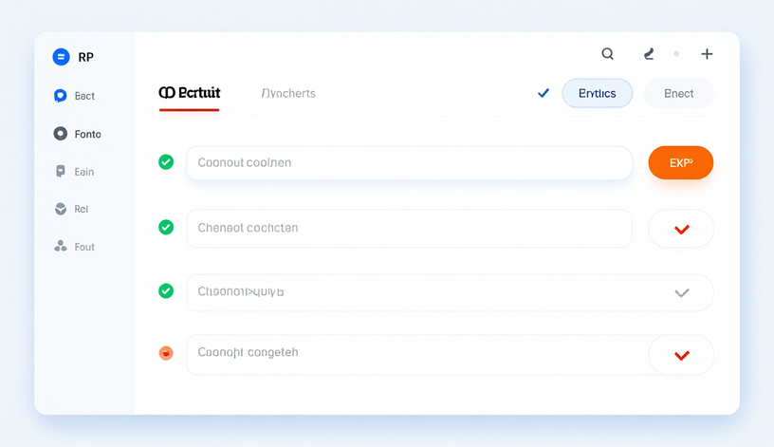
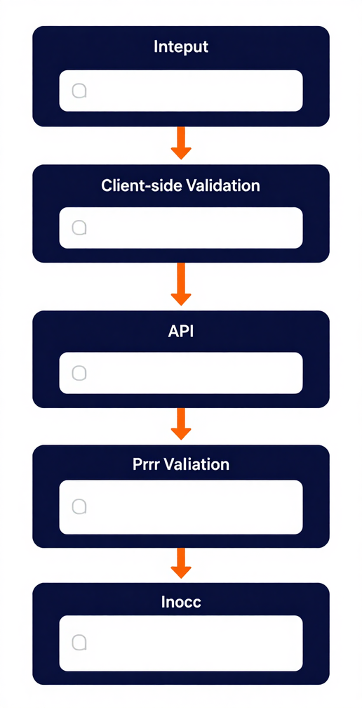



10
Home
About
Product
Validation Flow
User action → React UI → Zod validation → Axios API call → Backend response
Error Handling
Arabic error messages with user-friendly toast notifications
Frontend Interaction & Validation
Dual Validation
Frontend validation for UX, backend validation for security and data integrity

Slide 9


11
Home
About
Product
01
Technical Challenges
Hibernate many-to-many mappings, MapStruct DTO complexity, Oracle data types, JWT & HttpOnly cookies, CORS integration, optimization algorithm
Challenges
& Value
02
Business Value
Reduced errors, improved inventory accuracy, less paper waste, faster production planning, centralized data & access control

Slide 10


12
Home
About
Product
Status, Roadmap & Conclusion
Alamia Print is a comprehensive ERP system integrating production workflow, inventory, optimization, and security — tailored for real printing business needs, not just a generic CRUD app.
01
Completed Modules
Auth & Users · Companies · Products · Materials · Production Orders · Inventory · Optimization Algorithm - Excel export & Importing
02
Future Roadmap
Cost tracking · & reporting · Analytics & notifications · UI polish · Enhanced permissions

